Slide 1
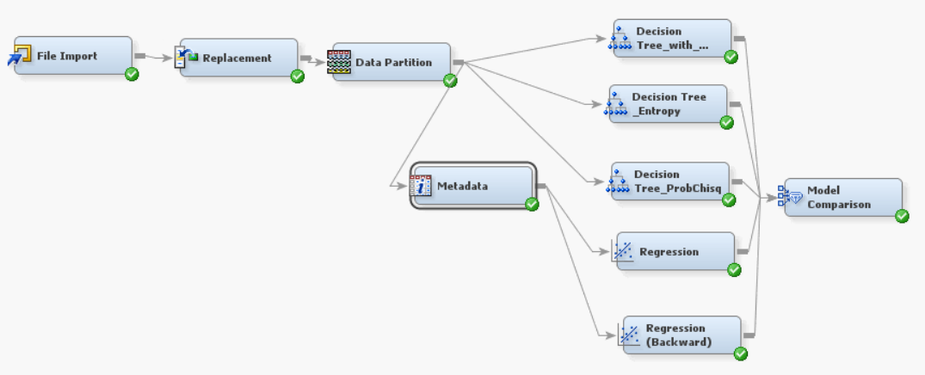
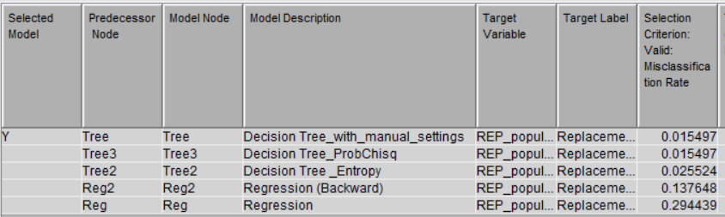
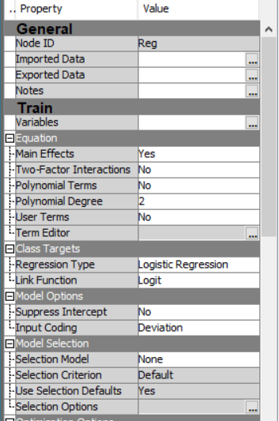
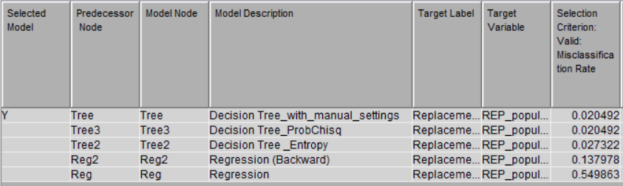
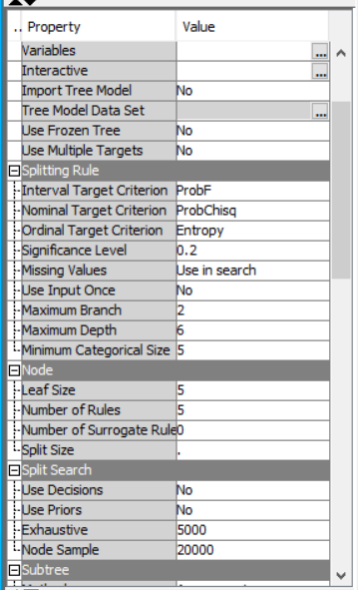
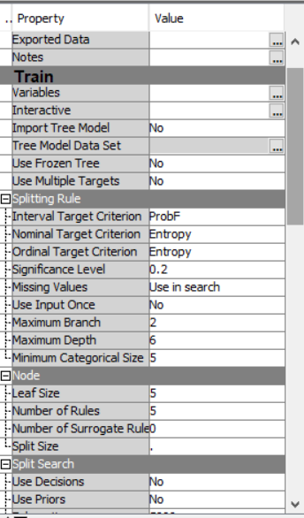
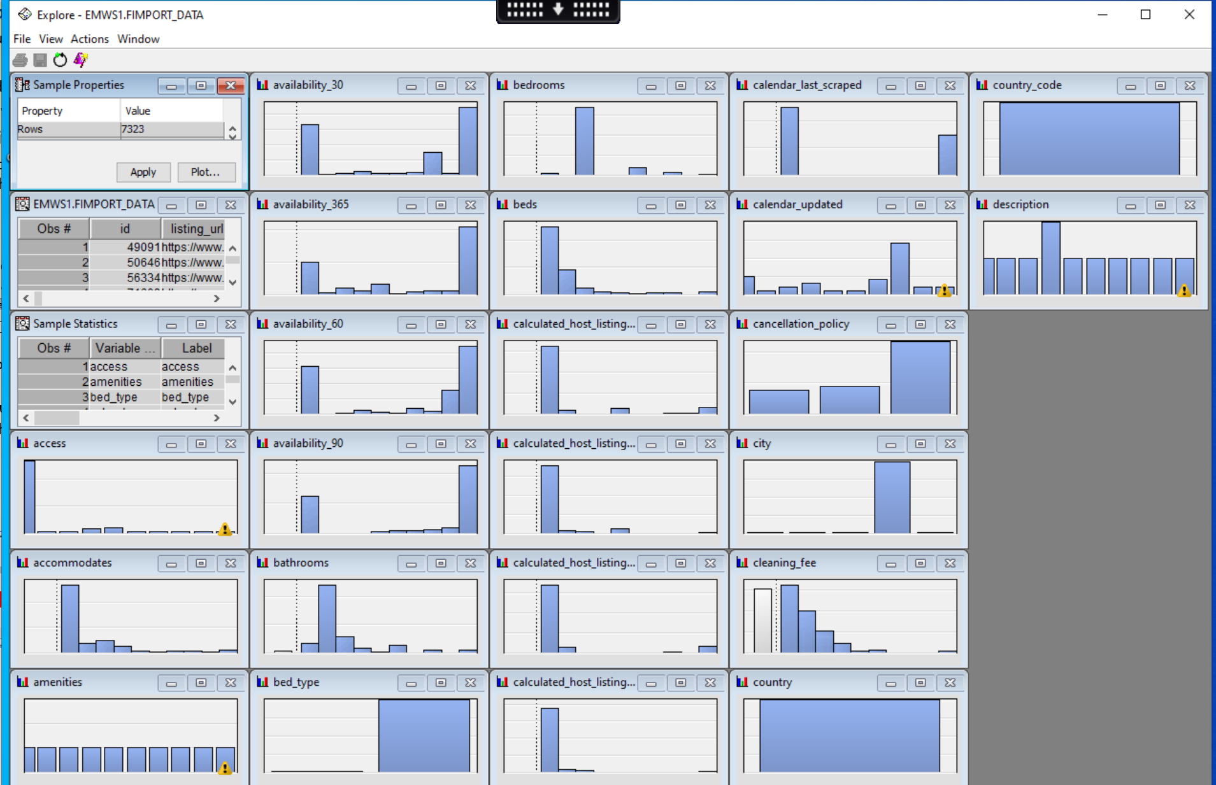
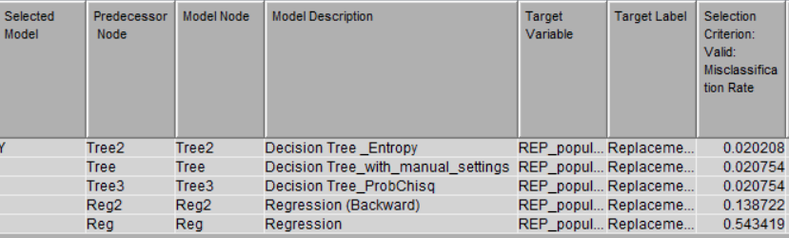
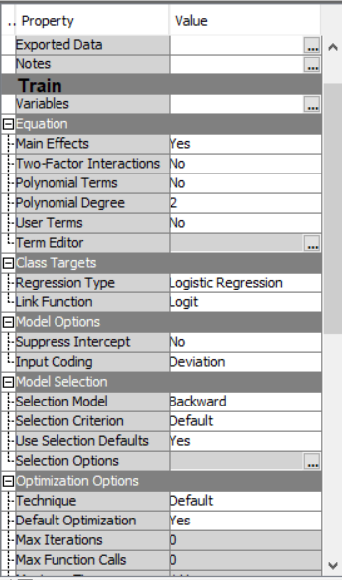
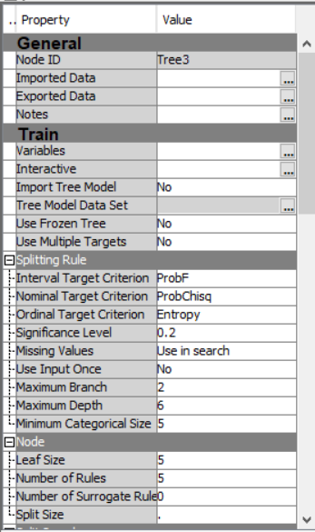
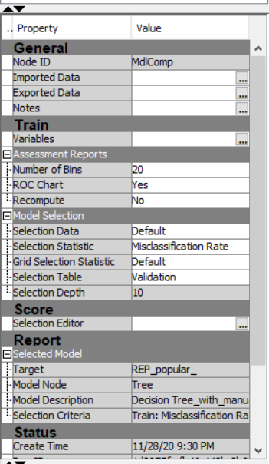
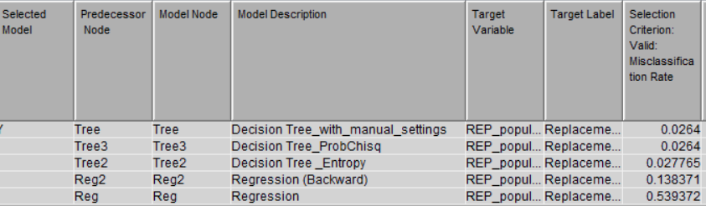
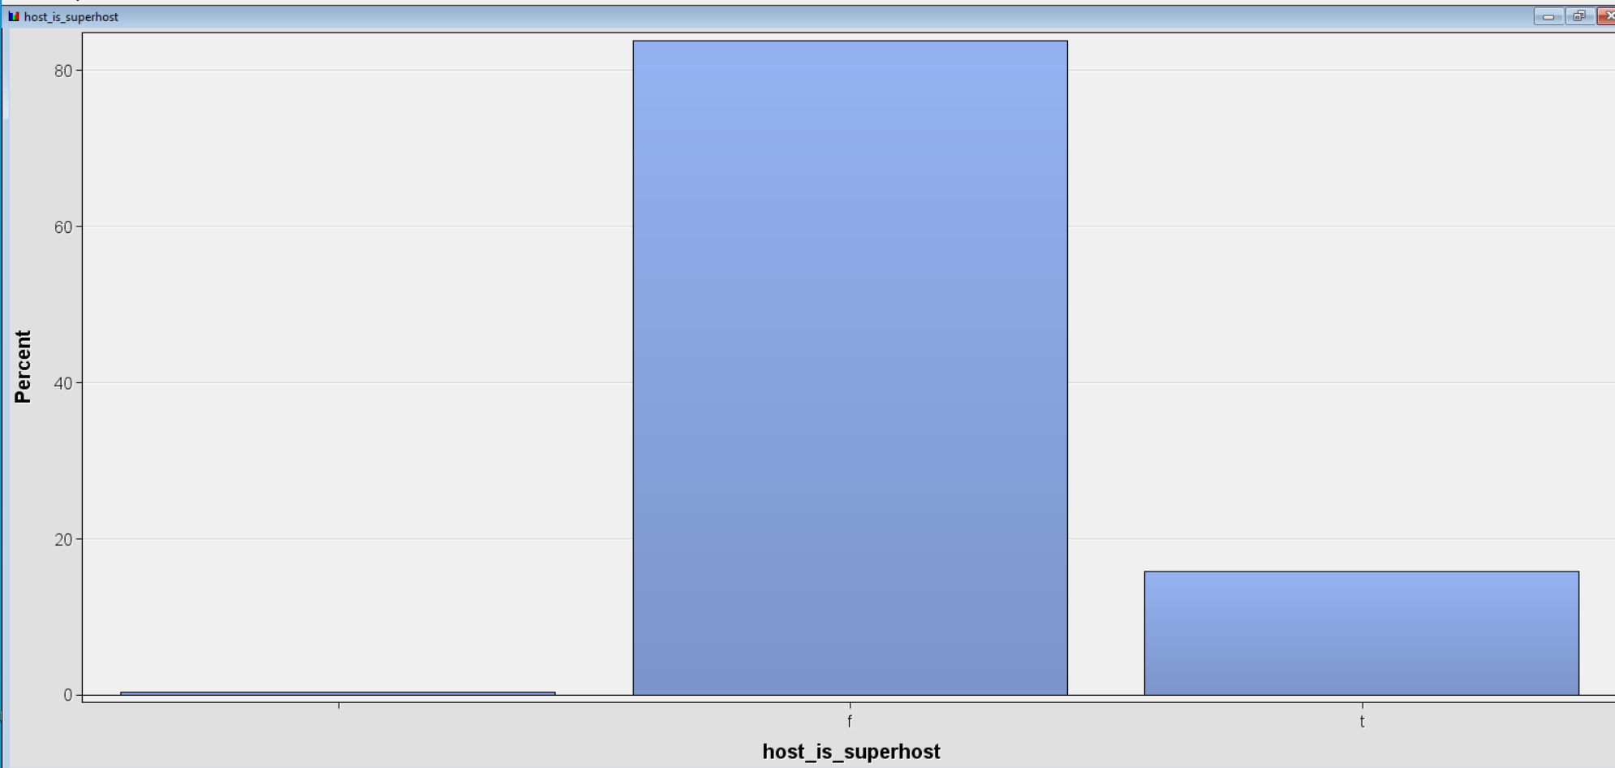
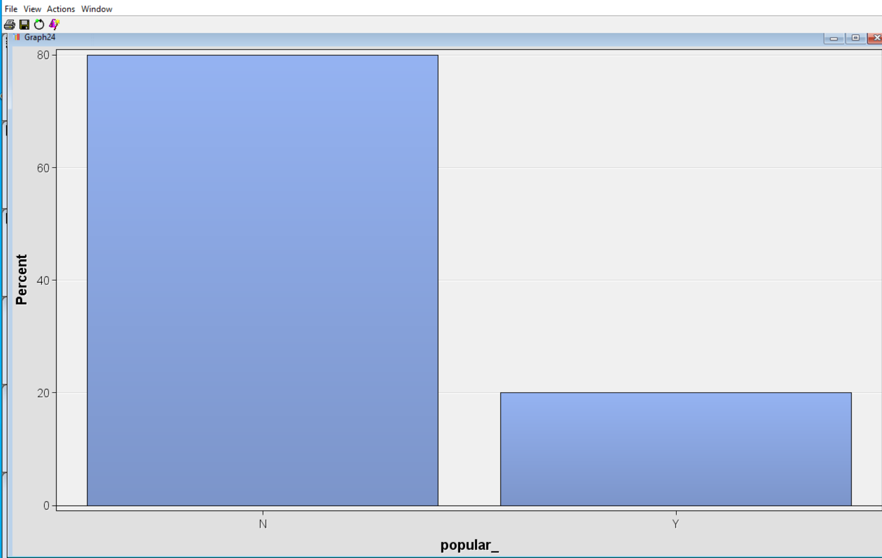
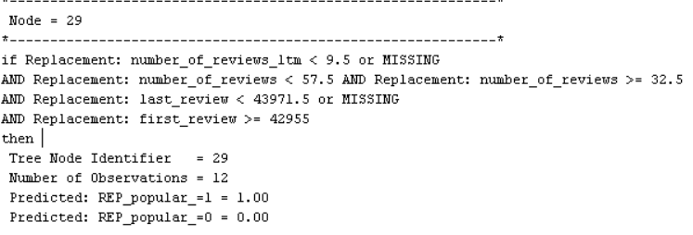
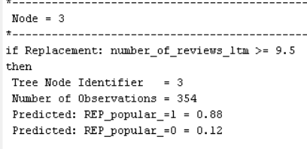
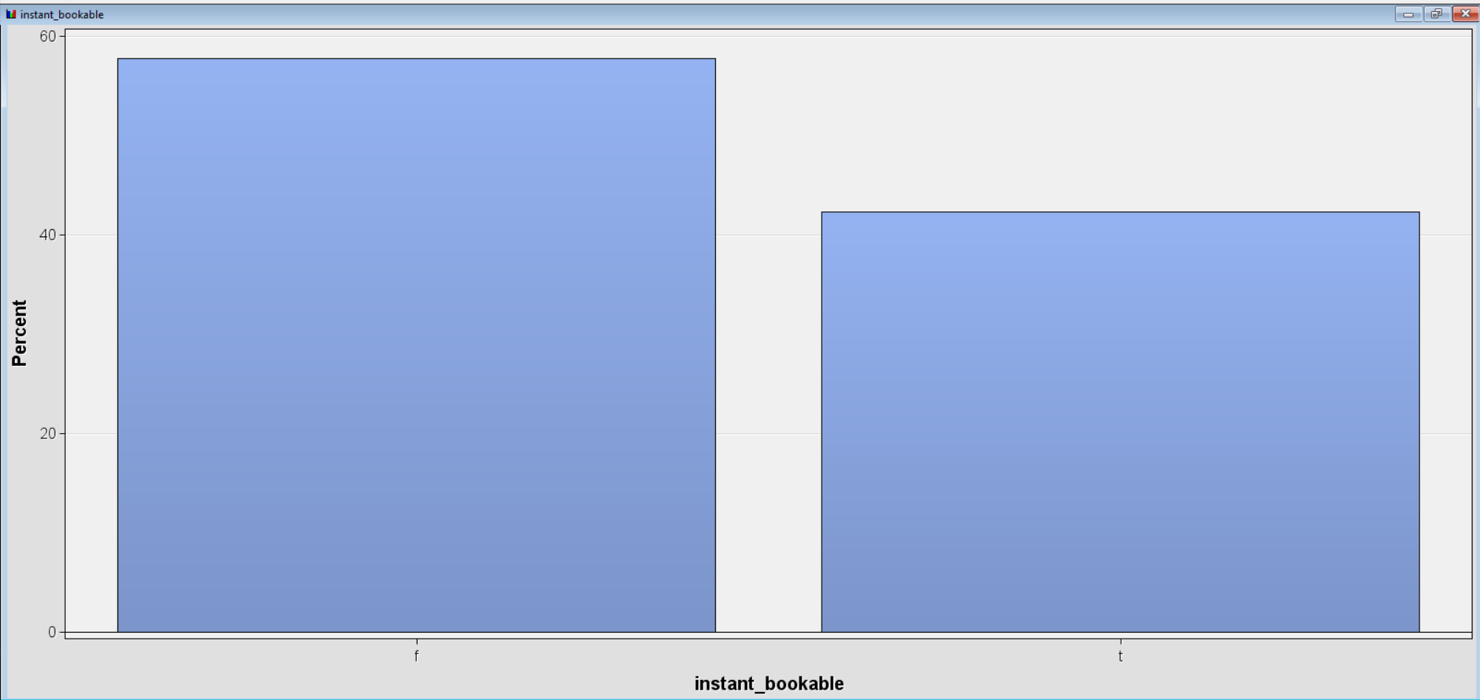
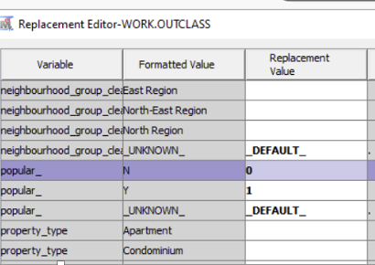
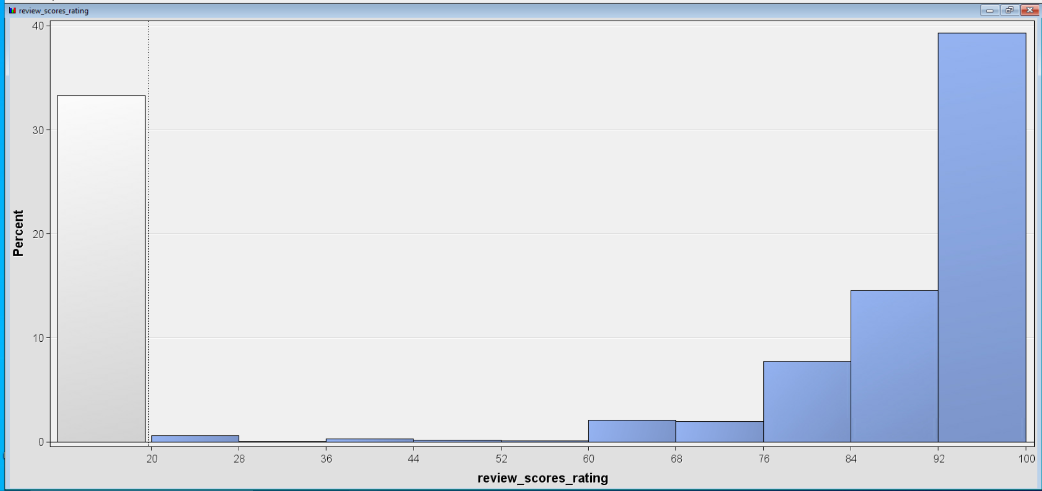
DABI ASSIGNMENT 2 – TASK B
Wee Kar Ghee , Admin no: 2080985A
Temasek Polytechnic, School of Informatics & IT – Up-Skill in Business Analytics
INTRODUCTION AND OBJECTIVES
WORKFLOW
Attached workflow consists of 3 predictive models
Airbnb is an online marketplace that connects people who want to rent out their homes with people who are looking for accommodations in that locale. It currently covers more than 81,000 cities and 191 countries worldwide. The company’s name comes from “air mattress B&B.”
For hosts, participating in Airbnb is a way to earn some income from their property, but with the risk that the guest might do damage to it. For guests, the advantage can be relatively inexpensive accommodations, but with the risk that the property won’t be as appealing as the listing made it seem. Hence, it may end up with one-time transaction with Airbnb.
Our objective is to find out the possibility to predict if a property listed on Airbnb is popular (booked frequently) with guests, using other information provided for the listed property .
Model Comparison Results (Fit Statistics) obtained from executing 4 different sets of partition configurations:
Set 1: Train 70%, Validate 15%, Test 15%
Regression
Decision Tree with manual settings
Decision Tree_Entropy
Set 2: Train 60%, Validate 20%, Test 20%
DATA EXPLORATION AND PREPARATION
The dataset has 7323 rows and 106 columns. It consists information about the property, price, popularity, host details, reiews, etc.
Use File Import node to import data with the following variable settings:
Use Data Partition to explore the variables in the imported data:
Backward Regression
Set 3: Train 50%, Validate 25%, Test 25%
Decision Tree_ProbChisq
Model Comparison
Data Partition node downstream from the File Import node.
In the properties pane, under the Data Set Allocations group, check that the settings are:
Training: 40.0
Validation: 30.0
Test: 30.0
To prepare the dataset, we have to use the Replacement node to recode the values in Popular from “Y’, “N” to 1 and 0.
Set 4: Train 40%, Validate 30%, Test 30%
FINDINGS AND RECOMMENDATIONS
Findings:
Based on misclassification rate, Decision Tree is the best mode for all 4 sets.
Set 1 has the lowest misclassification rate at 0.015 (i.e. 1.5%).
Decision Tree_with_manual_settings and Decision Tree_ProChisq are the champion models.
Recommendations:
Based on nodes 3 and 29, it is observed that first_review is the most crucial variable which determines the popularity of the property. The number_of_reviews_ltm (last 12months) and number_of_reviews are the next important variables.
- If number_of_reviews_ltm < 9.5 or missing And number_of_reviews < 57.5 And number_of_reviews >= 32.5 And last_review < 43971.5 or missing And first_review >= 42955 then popularity rate of property is 100%.
Popular - ‘Y’ : 80% , ‘N’ : 20%
host_is_superhost –
‘f’ : 83.89% , ‘t’ : 15.81%, NA : 0.30%
-If number_of_reviews_ltm > = 9.5 then popularity rate of property is 88%.
Based on the rules above, the evidence showed that the higher the number of reviews and when was the first review are what that is used to determine the popularity of the property. Thus it is recommended that system in Airbnb to ask customers for feedback after a stay or give freebies after feedback is done. There could also have a 3 months reminder email to remind customer of the feedback and to consider to use Airbnb again.
Instant_bookable –
‘f’ : 57.72% , ‘t’ : 42.28%
Review_scores_rating is right-skewed with 39.27% in range between 92-100. 33.3% does not have rating.
REFERENCES & CONTACT DETAILS
Not Applicable
DECLARATION: I declare that I am the originator of this work and that all other original sources used in this work have been appropriately acknowledged. I understand that plagiarism is the act of taking and using the whole or any part of another person’s work and presenting it as my own without proper acknowledgement. I also understand that plagiarism is an academic offence and that disciplinary action will be taken for plagiarism.

